Slide 1
GUI BASED LAB COMPONENTS MANAGEMENT SYSTEM

Slide 2
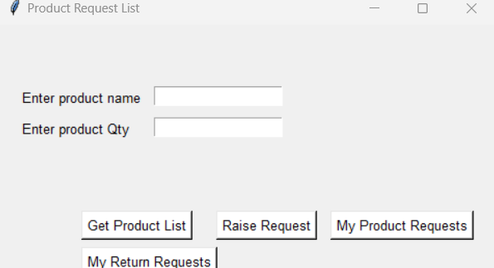
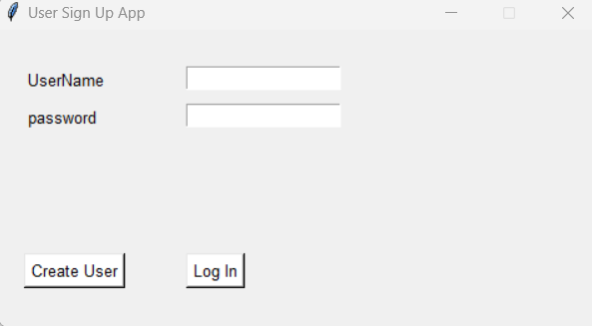
Objective:
Lab component inventory management system using Firebase and Tkinter GUI
The application is focused on recording and updating the components availability data, such that users and admin can check the status of the equipment and component in the laboratory.

Slide 3
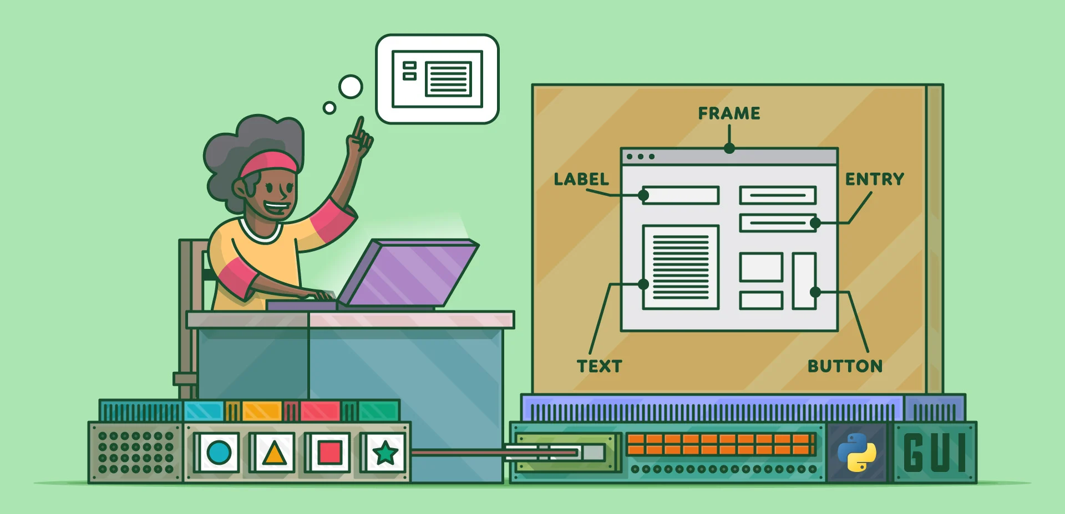
Frame Work Used:
Tkinter is a Python library for creating graphical user interfaces (GUIs) using the Tk GUI toolkit.
It is the standard Python library for creating desktop applications and is included with most Python distributions.
Tkinter provides a simple and easy-to-use interface for creating a wide variety of GUI elements, such as buttons, labels, text boxes, and menus.
It also includes support for events and dialog boxes, making it a powerful tool for creating interactive applications.

Slide 4
Here are some of the key features included in our system:
A main window that displays a list of available lab components and their current status (e.g. in stock, out of stock, checked out).
A way for users to check out and return lab components, with the option to specify the number of days for which the component will be checked out.
A way to view detailed information about a specific lab component, including its name, description, and location.
A way to add, edit, and delete lab components from the system.A way to search for lab components by name or description.
Option to report the component status like which component is out of stock and which component is check out.

Slide 5
GUI application details:
ADMIN | USER
User add and admin user add | User account creation
Component add, Component delete, Component Update, Component Read | Product search and Display
Accept product and reject or provide approval | Request product (search product) and send for approval from admin
Request back for the component if urgent. | After approval display the component in user.
After received the product we can change the status of the product | After returned we can update the product as returned in the app.

Slide 6
Flow Chart:
User access flow:
Admin access flow:
Search
Request
Approval status
Display return the component under user
Request List
Approval/Reject
Component CURD operation
Request back for the component

Slide 7
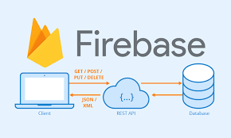
FireBase:
Firebase is a mobile and web application development platform developed by Google.
It provides a number of services such as authentication, real-time databases, hosting, cloud storage, and machine learning, which can be integrated into mobile and web applications to add functionality and improve performance.
One of the key features of Firebase is its real-time database, which allows for data to be synced across all connected clients in near real-time.
Firebase also provides a built-in authentication system,
which supports multiple authentication methods such
as email and password,phone number, and social
media providers like Google, Facebook and twitter.

Slide 8
Thank you

